Slide 1



Microsoft Azure
About
Architecture
Azure Workflow
Microsoft Azure Demo
END-TO-END WORKFLOW FOR BUSINESS INTELLIGENCE
Azure Datalake Gen2
Data Factory
Databricks
Power BI
EADS@4iapps.com

Slide 2
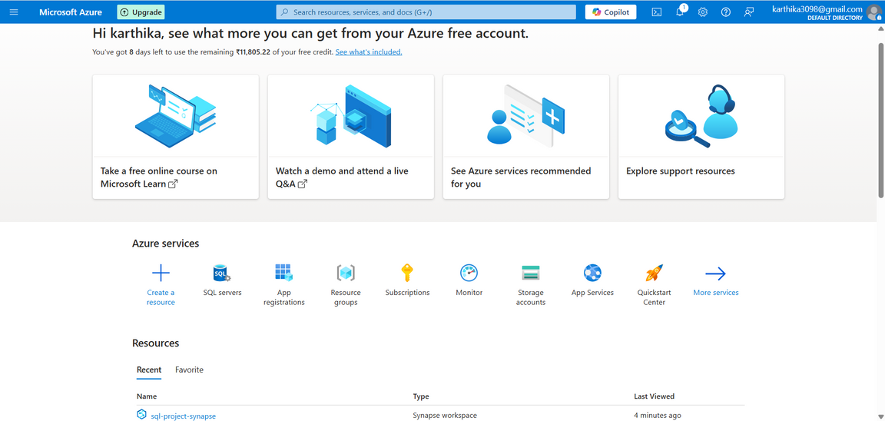

Microsoft Azure
About
What is Microsoft Azure?
Azure is a cloud computing platform by Microsoft that offers various services for computing, analytics, storage, and networking. It is widely used for building, deploying, and managing applications, as well as providing a unified data analytics ecosystem.
Why Azure for Our Workflow?
Scalability & Flexibility: Seamlessly scale resources with Azure to meet demands.
Integrated Ecosystem: Full integration across services like Azure Data Factory, Azure Data Lake, Azure Databricks, and Power BI.
What We Will Demonstrate:
An end-to-end workflow from data extraction to reporting using Azure Data Factory, Azure Data Lake, Azure Databricks, and Power BI.
Connecting transformed data from Azure Data Lake Storage Gen2 to Power BI

Slide 3
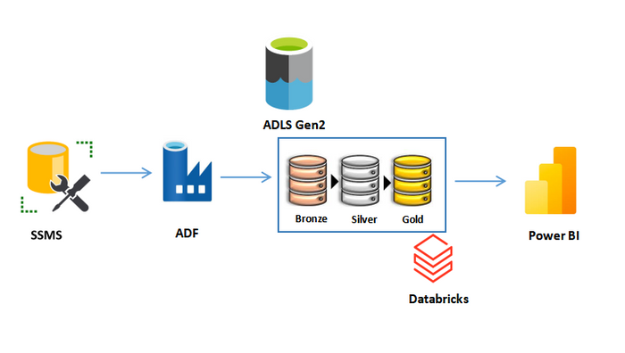
Microsoft Azure
Architecture
Workflow Architecture
Components Utilized:
SSMS (SQL Server Management Studio): Extracts data from the AdventureWorks Sales Analytics dataset.
Azure Data Factory (ADF):
Linked Services: Created linked services for both ADLS (Azure Data Lake Storage) and SSMS for seamless data transfer.
Datasets: Defined datasets to manage data stored in both ADLS and SSMS.
Pipelines: Designed pipelines to copy data from SSMS to the ADLS Bronze container. The pipeline orchestrates the process of loading raw data into ADLS.
Azure Data Lake Storage Gen2 (ADLS):
Bronze Layer: Stores raw, untransformed data.
Silver Layer: Stores cleaned and transformed data.
Gold Layer: Contains aggregated and business-ready data for analytics.
Azure Databricks:
Transformation: Databricks notebooks are used to perform advanced data transformations on the data stored in the Bronze container, and the transformed data is saved into the Silver container.
The final transformations are then pushed into the Gold container, which contains the most refined version of the data.
Power BI: Visualizes the Gold layer data in interactive dashboards and reports.

Slide 4
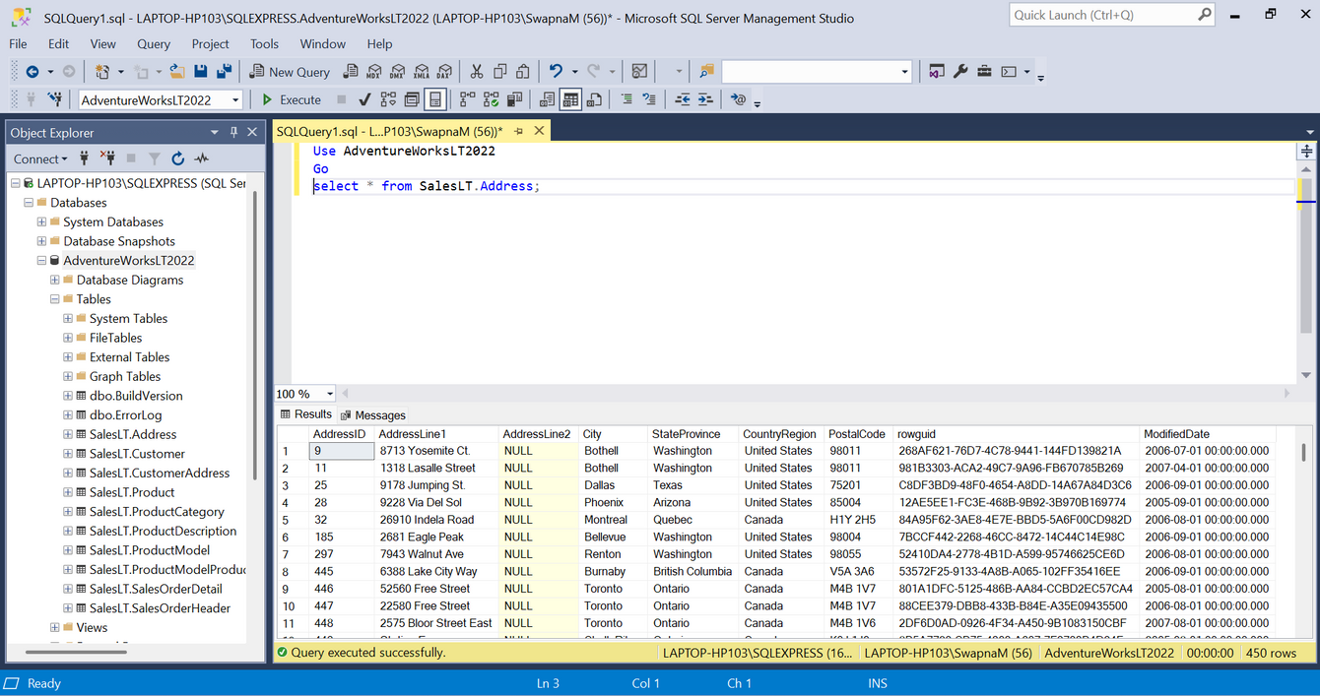
Microsoft Azure
SQL Server Management Studio
SQL Server Management Studio (SSMS) is a powerful tool developed by Microsoft for managing SQL Server databases.
It provides a graphical user interface (GUI) for database administrators and developers to perform tasks such as:
Writing and executing SQL queries
Managing databases, tables, and users
Configuring security and permissions
Monitoring performance and logs
Backup and restore operations
SSMS is an on-premises SQL Server that we used as a data source in our ADF pipeline. We configured Linked Services by providing the necessary credentials. To run the pipeline, we used Self-hosted Integration Runtime (SHIR) to establish a connection between on-premises data and ADF. However, when working with Azure services, ADF provides an Auto Integration Runtime for seamless connectivity.

Slide 5
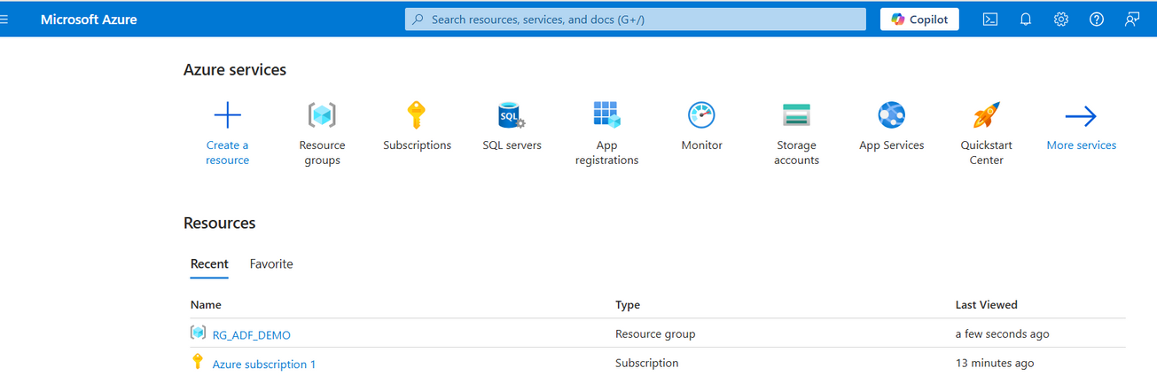
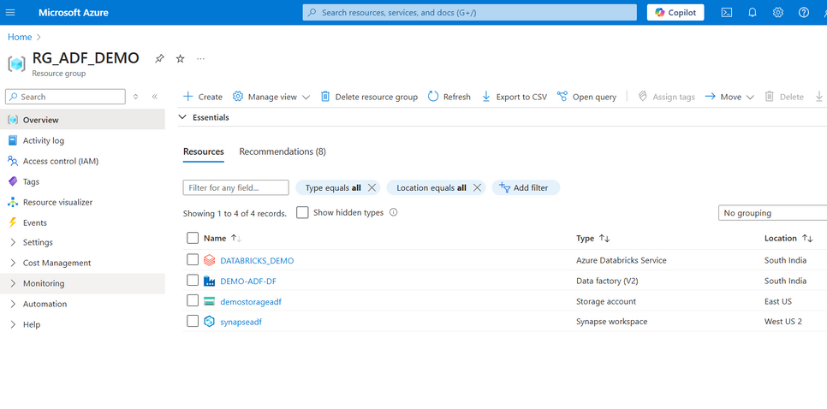

Microsoft Azure
Azure Data Factory Overview
Resource Group Creation
What is a Resource Group?
A Resource Group in Azure is a container for managing related resources in your project.
It helps organize and manage all resources within a project in a unified manner.
In this architecture, we have created the resource group "RG_ADF_DEMO" to house all the Azure services involved in the workflow
-----------
Components in the Resource Group
Within "RG_ADF_DEMO", we have added the following resources:
Azure Data Factory (ADF): The orchestrator for data movement and transformation.
Azure Storage Account: Stores raw, transformed, and processed data.
Azure Databricks: Used for advanced data transformation and machine learning.
Azure Synapse Analytics: Integrated for any large-scale analytics tasks.
ADF Resource: We have created the "DEMO-ADF-DF" instance under this resource group, which handles the data processing pipeline.
----------

Slide 6
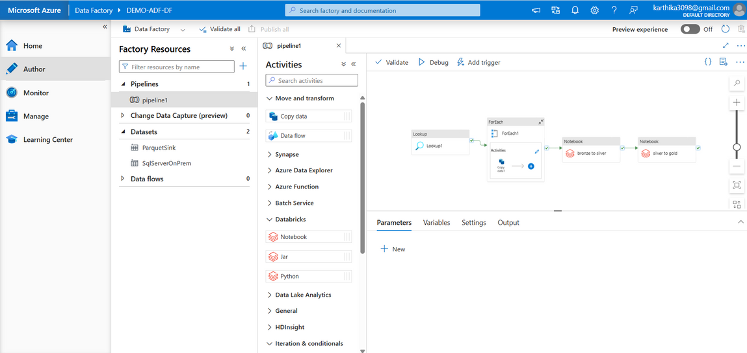
Microsoft Azure
Azure Data Factory Overview
ADF Home Page Overview
The ADF portal offers several components: Home, Author, Monitor, Manage, and Learning Center.
Authoring is where all workflows are built and managed, so we’ll focus on this section.
Factory Resources:
We have created pipelines, datasets, and data flows under this section to manage data movements and transformations.
In the Author section, you can create and manage your workflows and activities in a seamless manner.
Pipeline Creation:
We have created Pipeline1, where multiple data movement and transformation activities are performed.
Pipeline Activities and Data Transformation
Move and Transform Data:
The Copy Data activity is used to move data from the SQL Server to the Bronze container in ADLS.
ForEach activity loops through each dataset and applies transformations.
Databricks Integration:
After data is moved to the Bronze container, we use Databricks notebooks for transforming this raw data into the Silver and Gold containers.
Notebook 1: Transforms data from Bronze to Silver.
Notebook 2: Transforms data from Silver to Gold.
These transformations are triggered automatically when the pipeline runs.
ForEach Activity:
The ForEach activity iterates over a list of data, running the same set of activities for each item in the collection. In this case, it helps to loop through datasets for data movement and transformation.

Slide 7
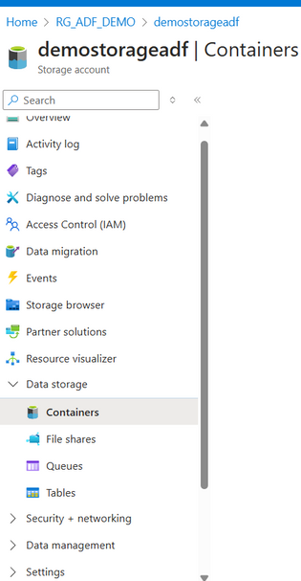
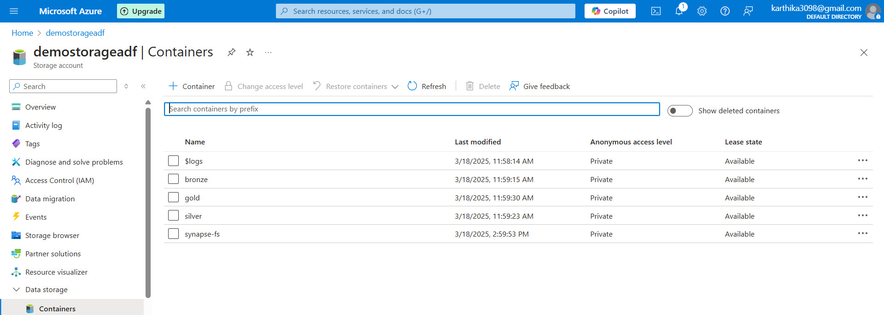
Microsoft Azure
Medallion Architecture
Storage Account Containers in Medallion Architecture
Storage Account Containers in Medallion Architecture
Medallion Architecture organizes data into three layers for efficient processing: Bronze, Silver, and Gold.
Bronze Layer:
Stores raw data from source systems.
Acts as a staging area for unprocessed data.
Example: Raw sales transactions.
Silver Layer:
Contains cleaned and transformed data.
Data is filtered, enriched, and prepared for deeper analysis.
Example: Cleaned sales data, enriched customer info.
Gold Layer:
Holds business-ready, aggregated data for reporting and decision-making.
Final data used for dashboards and analytics.
Example: KPI metrics, final sales reports.
Benefits:
Scalability and data quality through incremental transformations.
Separation of concerns, ensuring efficient and organized data flow.

Slide 8
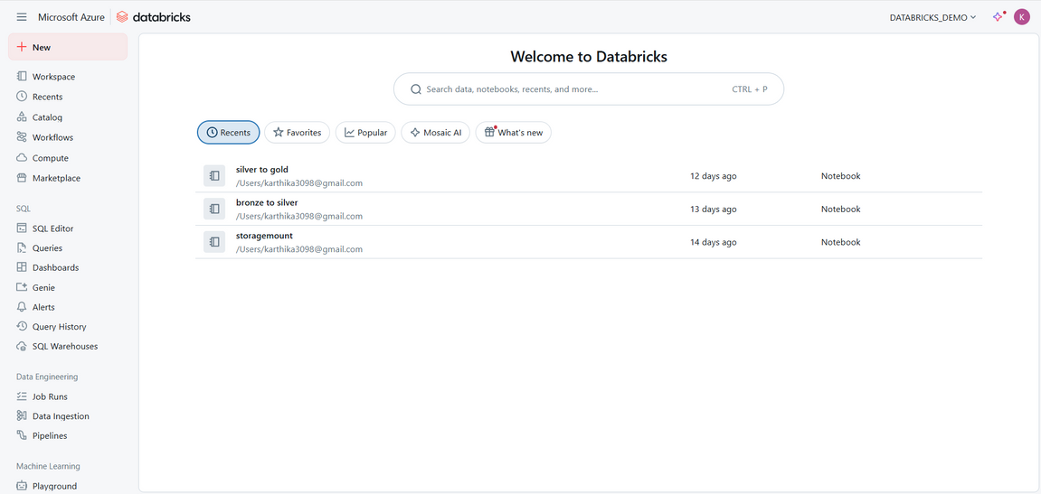
Microsoft Azure
Databricks
What is Azure Databricks?
Azure Databricks is an Apache Spark-based analytics platform optimized for the Microsoft Azure cloud environment. It integrates the capabilities of Apache Spark with the scalability and flexibility of Azure to provide a unified analytics workspace for data engineers, data scientists, and analysts.
Azure Databricks for Data Transformation
Purpose:
Databricks was used for data transformation in the Azure workflow.
It provided a scalable environment to run notebooks and perform advanced data processing using Apache Spark.
Key Steps:
Cluster Creation:
A Databricks cluster was created to run the notebooks for data processing.
Using Apache Spark:
Apache Spark language was used within the notebook for efficient data transformation.
Mounting Containers:
Mounted the Bronze, Silver, and Gold containers in Databricks to easily access and manage data across the different layers.
Data Transformation:
Data from the Bronze container was processed with partial transformations and stored in the Silver container.
The transformation was automated for consistency and efficiency.
Final Transformation:
The final transformations were applied to the data in the Silver container, and the results were stored in the Gold container.
Ready for Reporting:
The Gold container holds the business-ready data, ready for querying and integration with Power BI for visualization.

Slide 9

Data Extraction: Data is pulled from SSMS using ADF pipelines.
Azure Workflow
Storage in ADLS: The raw data is stored in the Bronze layer, and further transformations take place in the Silver layer.
Transformation in Databricks: The transformation process takes data from the Bronze layer, processes it in Databricks, and stores the cleansed and structured data in the Silver layer.
Final Aggregation in Gold Layer: After further processing, the data is saved in the Gold layer for final reporting and analytics.
Integration with ADF: Databricks notebooks are connected to the ADF pipeline, triggering the data transformation and movement across the layers.
Efficient data transformation pipeline with integration between ADF, Databricks, and ADLS.
Scalable data storage and processing using Azure's cloud capabilities.
Streamlined data analytics workflow from raw data to final reporting in Power BI.
This updated version reflects the complete architecture and data flow that you have implemented in Azure.
Dataflow
Benefits

Slide 10
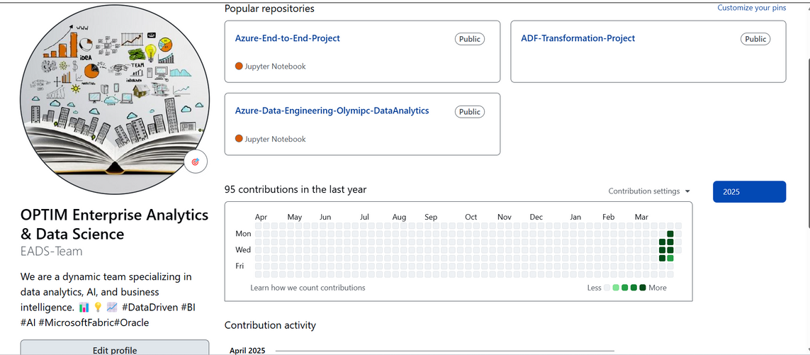
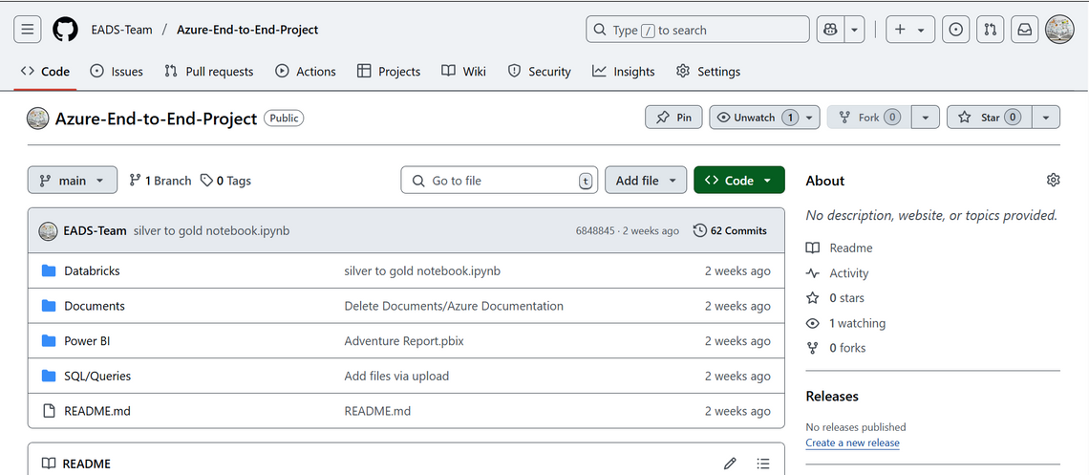
Microsoft Azure
Github
GitHub Repository Overview
We have created a GitHub repository to manage and share our project code, documentation, and resources.
All our projects, including Azure End-to-End Project, are uploaded here for version control, collaboration, and easy access.
Project Overview:
The repository contains multiple folders:
Databricks: Contains notebooks for data transformation.
Documents: Contains Azure-related documentation.
Power BI: Contains the Power BI reports.
SQL/Queries: Includes SQL scripts for data processing.
Example File: The "silver to gold notebook.ipynb" is one of the Jupyter notebooks for the transformation process from Silver to Gold in the Medallion architecture.
Repository Features:
Code Versioning: Easily track and manage changes in the project.
Collaboration: Allows team members to contribute, review, and track the project's progress.
Documentation: All relevant project documents are organized in the repository for easy access.

Slide 11
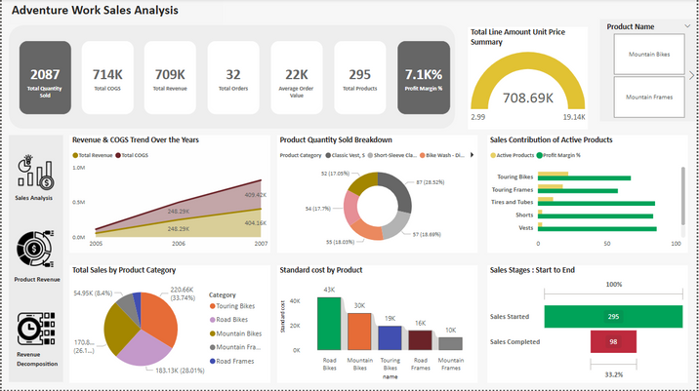
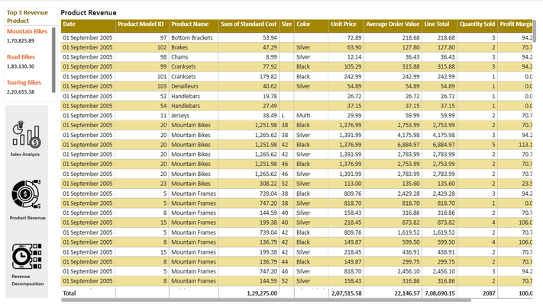
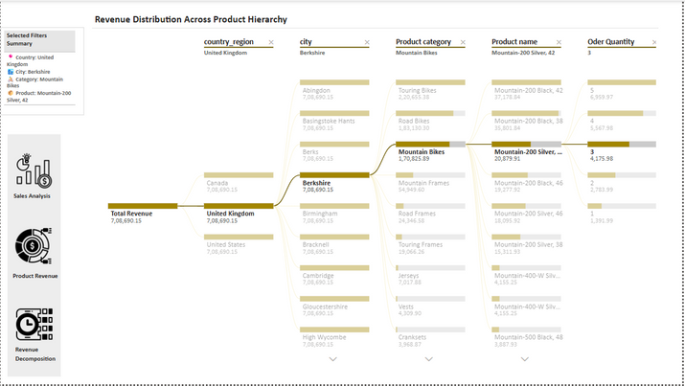
Microsoft Azure
Power BI Report - Azure Blob Storage Integration
Power BI Report Overview:
We have created an interactive Power BI report by connecting it to Azure Blob Storage (Gold Layer of the Medallion architecture).
The report provides insights and visualizations of the transformed data, helping with decision-making and business analysis.
Key Features:
Data Source: The report is connected to the Gold container in Azure Blob Storage, where the final business-ready data resides.
Visualizations: Includes graphs, charts, and tables to represent key metrics such as sales, customer behavior, and more.
Interactivity: Users can filter, drill down, and interact with the data to gain deeper insights.
Outcome:
The Power BI report showcases the final stage of data transformation and provides valuable insights for business stakeholders.

Slide 12

Microsoft Azure
About
Architecture
Azure Workflow
Thank You
FOR YOUR ATTENTION
EADS@4iapps.com

